Slide 1

Rental Property Price Prediction
ENSF 611 FINAL PROJECT
Cory Wu, Rick Zhang

Slide 2


Problem Statement
Use Machine Learning Models to Predict Price of Rental Properties
Location
Size
Pet Friendly?
...
…
….

Slide 3
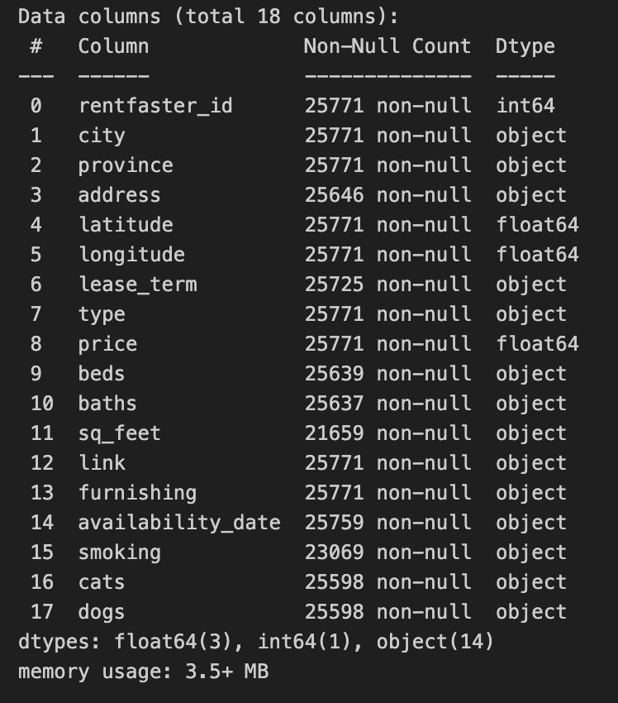

Data Set Description
Our data file has 18 columns. We chose ’price’ as the target and the rest as features.

Slide 4

Model Selection
Linear Regression
Random Forest Regression
K-nearest Neighbors Regression
Gradient Boosted Tree Regression

Slide 5
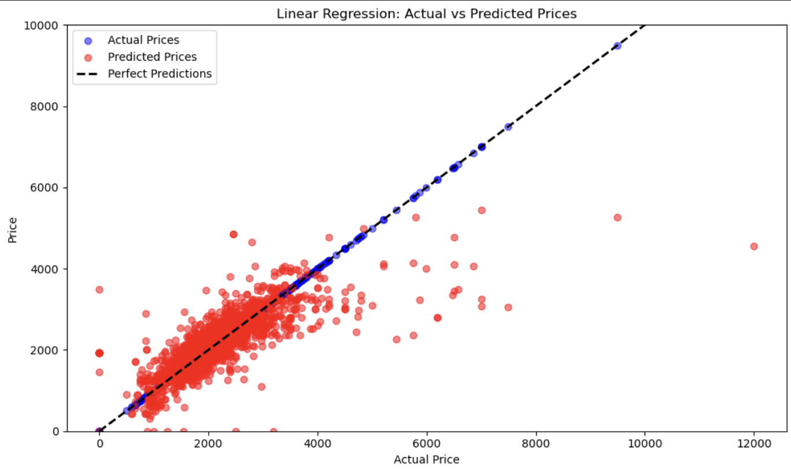
Linear Regression
R2 Score:
0.601

Slide 6
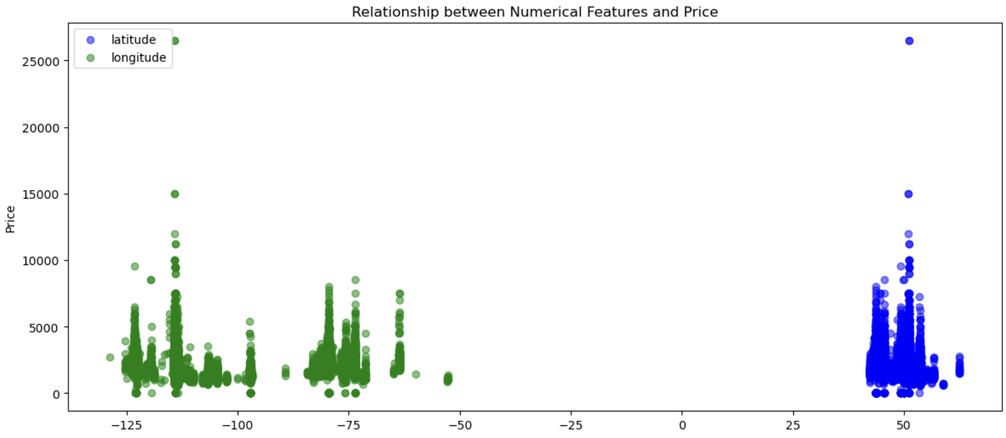
Linear Regression

Slide 7
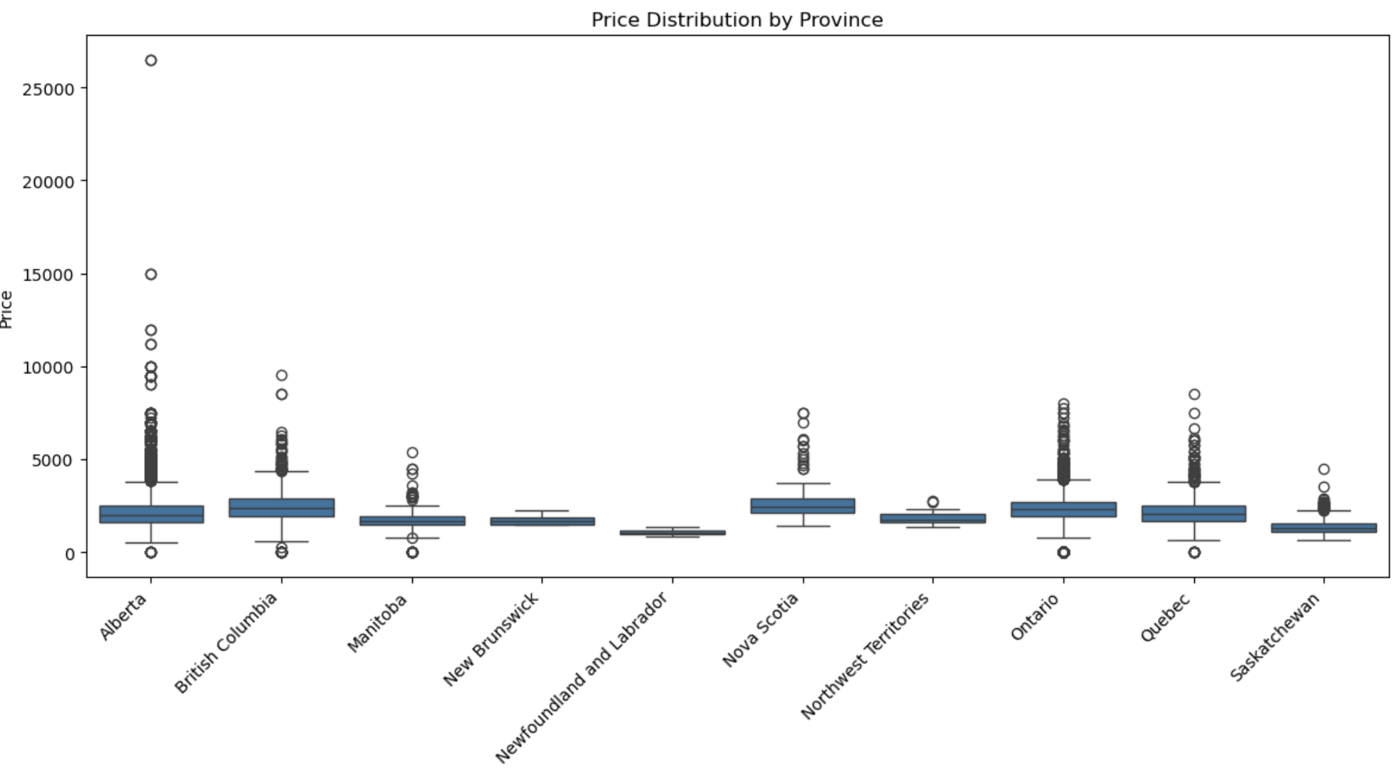
Linear Regression

